Slide 1



Arquitecturas Serverless en AWS con SST
FRANCISCO BERGERET, JUAN CESAROTTI, GABRIEL PERRONE
May, 2023

Slide 2



About us
Francisco Bergeret Technical Manager & Backend Dev
Gabriel Perrone Technical Manager & Mobile Dev
Juan Cesarotti Full Stack Dev
Notes:
Mobile Android
.NET

Slide 3
Agenda
Introducción:
Infraestructura como Código
Serverless
SST
Demo "Kahoot Clone"
Competencia en vivo
Q&A

Slide 4
Objetivo
"SST es un framework de infraestructura como código (IaC) construido en TypeScript sobre Amazon Cloud Development Kit (CDK) para desarrollar y mantener aplicaciones serverless en una sola base de código."

Slide 5
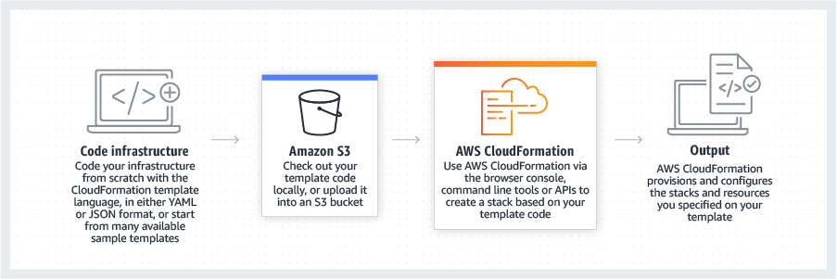
Infraestructura como código (IaC)
"Infrastructure as code (IaC) is the process of managing and provisioning computer data centers through machine-readable definition files, rather than physical hardware configuration or interactive configuration tools." .- Wikipedia

Slide 6
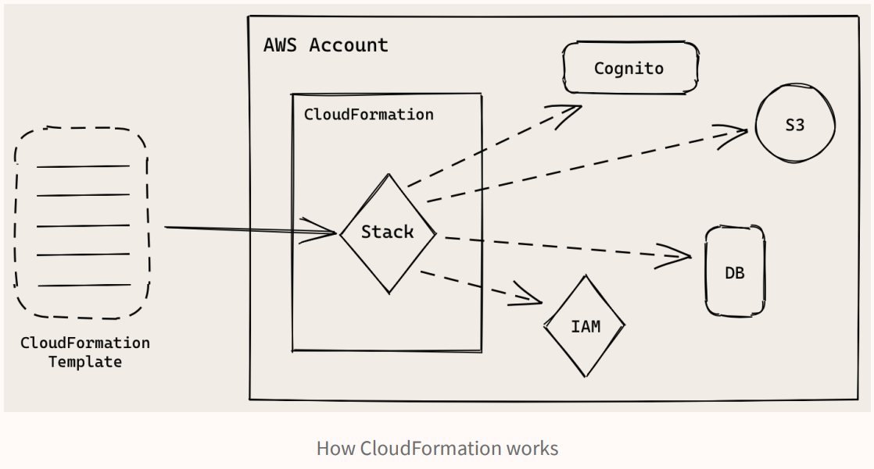
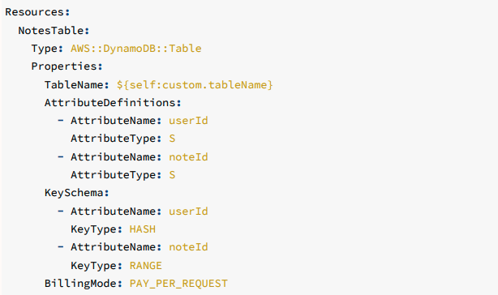
Cloudformation Templates
Notes:
In a CloudFormation template you need to define all the resources that your app needs. This includes quite a large number of minor resources that you won’t be directly interacting with. So your templates can easily be a few hundred lines long.
YAML and JSON are easy to get started with. But it can be really hard to maintain large CloudFormation templates. And since these are just simple definition files, it makes it hard to reuse and compose them.
Finally, the learning curve for CloudFormation templates can be really steep. You’ll find yourself constantly looking at the documentation to figure out how to define your resources.
A stack is a collection of AWS resources that you can manage as a single unit. In other words, you can create, update, or delete a collection of resources by creating, updating, or deleting stacks. All the resources in a stack are defined by the stack's AWS CloudFormation template. A stack, for instance, can include all the resources required to run a web application, such as a web server, a database, and networking rules. If you no longer require that web application, you can simply delete the stack, and all of its related resources are deleted.

Slide 7
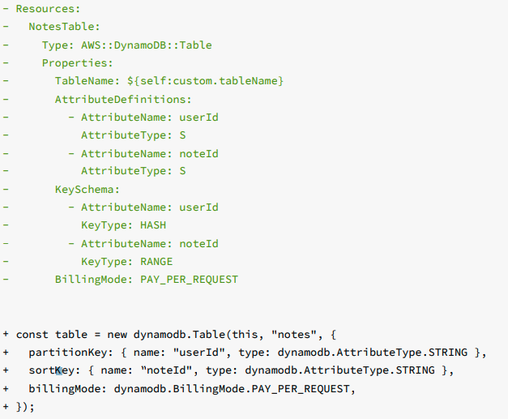
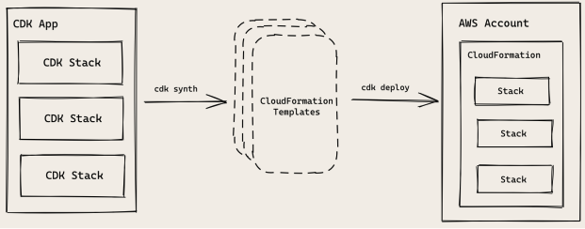
Cloud Development Kit (CDK)

Slide 8
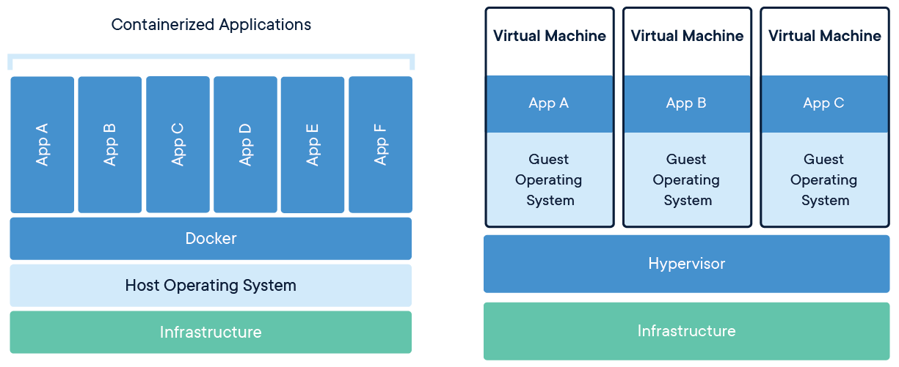
Contenerización vs Virtual Machines
Notes:
Un contenedor es una tecnología que permite empaquetar y aislar una aplicación junto con todas sus dependencias (como bibliotecas, archivos de configuración, etc.) en una unidad portátil y ligera. A diferencia de las máquinas virtuales (VM), que simulan un sistema operativo completo y todo el hardware necesario, los contenedores comparten el sistema operativo del host y utilizan sus recursos de manera eficiente.
Los contenedores son más rápidos que las máquinas virtuales porque:
Menos recursos: Al compartir el sistema operativo del host y no necesitar emular el hardware, los contenedores utilizan menos recursos (CPU, memoria, almacenamiento), lo que resulta en un inicio y rendimiento más rápidos.
Portabilidad: Los contenedores son más fáciles de mover entre diferentes sistemas, lo que permite implementar aplicaciones rápidamente en diferentes entornos sin preocuparse por las incompatibilidades.
Aislamiento: Aunque los contenedores comparten el sistema operativo, mantienen un aislamiento entre sí, lo que reduce los conflictos y facilita la administración y mantenimiento.
La diferencia de SOs en Contenedores y VMs
Nivel de abstracción: En una máquina virtual, el sistema operativo base se ejecuta como una instancia separada e independiente en un hipervisor. Cada máquina virtual tiene su propio sistema operativo, lo que requiere más recursos. En el caso de los contenedores, el sistema operativo base es una imagen ligera que contiene solo los componentes mínimos necesarios para ejecutar la aplicación y sus dependencias. Esto permite a los contenedores ser más ligeros y rápidos.
Compartir recursos: Aunque los contenedores tienen un sistema operativo base, en realidad comparten el kernel del sistema operativo del host. En otras palabras, múltiples contenedores en el mismo host pueden usar el mismo kernel del sistema operativo subyacente, lo que minimiza la sobrecarga en los recursos del sistema en comparación con las máquinas virtuales.
Imagen del sistema operativo: En un contenedor, el sistema operativo base es una imagen que se puede almacenar, compartir y reutilizar fácilmente. Esto facilita la implementación y el mantenimiento de aplicaciones, ya que se pueden crear y distribuir imágenes del sistema operativo que contengan todas las dependencias y configuraciones necesarias para la aplicación.
Inicio más rápido: Dado que los contenedores solo requieren cargar la imagen del sistema operativo base y no tienen que arrancar un sistema operativo completo como en una máquina virtual, el proceso de inicio es mucho más rápido.

Slide 9
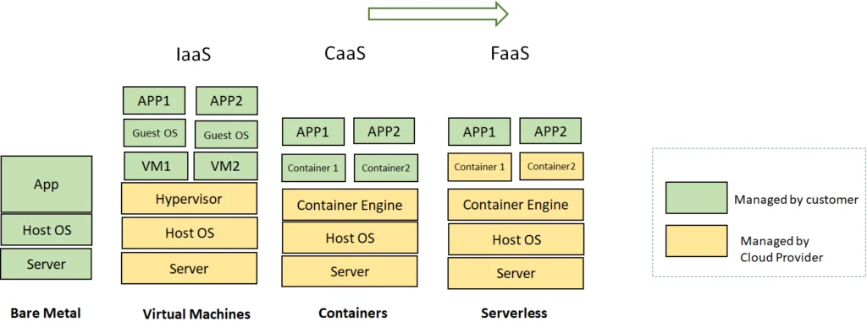
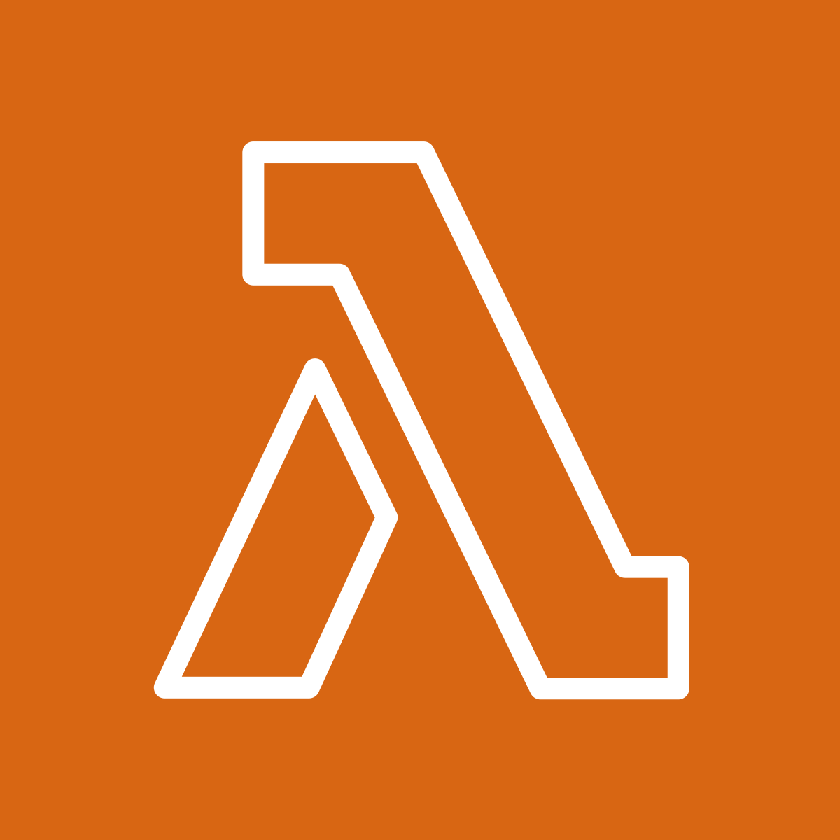
Modelos de Computación hasta FaaS
(En AWS)
Notes:
Function as a Service (FaaS) is a cloud computing execution model that allows developers to deploy and run individual functions or pieces of code in response to specific events or triggers, without worrying about managing the underlying infrastructure. FaaS is a core component of serverless computing and enables developers to focus on writing code and defining the execution triggers while the cloud provider handles server management, scaling, and resource provisioning.
AWS Lambda abstracts away many of the underlying details, it leverages containers to run your code in isolated environments called execution contexts. Each execution context is essentially a lightweight, ephemeral container that hosts your Lambda function code and its dependencies.
When you create a Lambda function, AWS packages your code and any required dependencies into a deployment package. This package is then used to create a container, which runs the function when triggered. AWS manages the container's lifecycle, including provisioning, scaling, patching, and monitoring. This allows you to focus on your code without worrying about the underlying infrastructure.

Slide 10
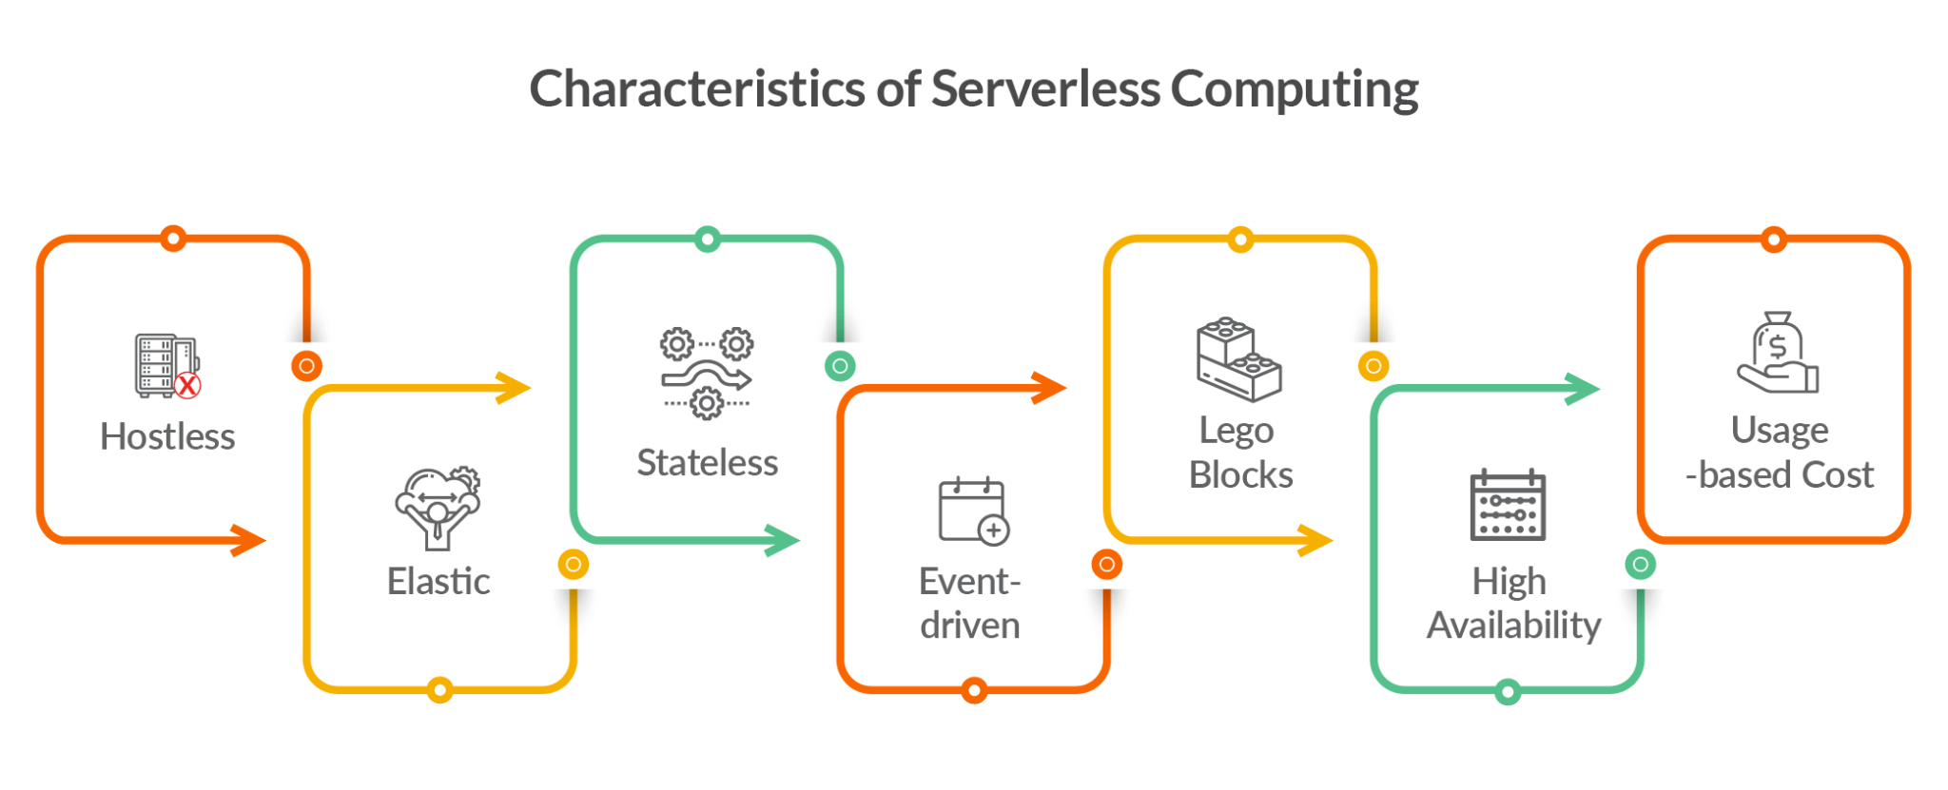
Serverless Computing
FaaS
Notes:
In the FaaS model, developers create stateless functions that can be invoked through various events or triggers, such as HTTP requests, changes in data, or messages from other services. The cloud provider takes care of launching, running, and terminating the required computing resources to execute the functions. Developers are billed based on the actual execution time and resource consumption of their functions, instead of pre-allocated or reserved resources.
Key characteristics of FaaS include:
Stateless functions: Functions are designed to be stateless, meaning they do not store or maintain state information between invocations. Any required state information must be stored externally, for example, in a database or a cache.
Event-driven: Functions are triggered by specific events, such as API requests, changes in data, or messages from other services.
Scalability: The cloud provider automatically scales the infrastructure to handle the number of function invocations, accommodating varying workloads and concurrency levels.
Cost optimization: Billing is based on the actual execution time and resources consumed, rather than reserved or pre-allocated resources. This can lead to cost savings, especially for variable or sporadic workloads.
Reduced operational overhead: Developers don't need to worry about server management, capacity planning, or infrastructure maintenance, allowing them to focus on writing code and delivering business value.

Slide 11
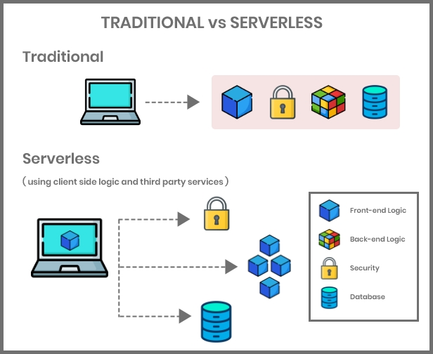
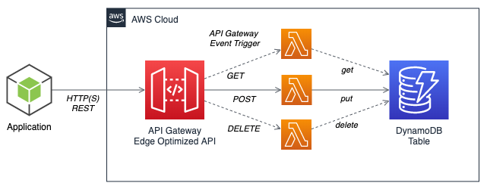
Serverless
Serverless Computing (FaaS)
Serverless Architecture
Notes:
Serverless computing, also known as Function as a Service (FaaS), is an innovative cloud computing paradigm that simplifies the development and deployment of applications by abstracting away server management and infrastructure provisioning. Instead of managing physical or virtual servers, developers can focus on writing code and defining the execution triggers, while the underlying infrastructure dynamically scales based on the workload.
The term "serverless" can be somewhat misleading, as servers are still involved in executing the code. However, it emphasizes the developer's perspective, who no longer needs to be concerned with server management, capacity planning, or scaling. Serverless platforms, provided by major cloud service providers like AWS Lambda, Google Cloud Functions, and Microsoft Azure Functions, handle these tasks automatically, allowing developers to concentrate on the business logic and code.
Key benefits of serverless computing include cost optimization, as users are billed only for the actual compute time, automatic scaling based on demand, and a reduced operational burden, which translates to increased agility and faster time to market. It is particularly well-suited for event-driven, stateless, and highly variable workloads, such as data processing, real-time analytics, and microservices. However, it may not be the best choice for long-running, compute-intensive, or stateful applications due to limitations in execution time, memory, and storage.

Slide 12
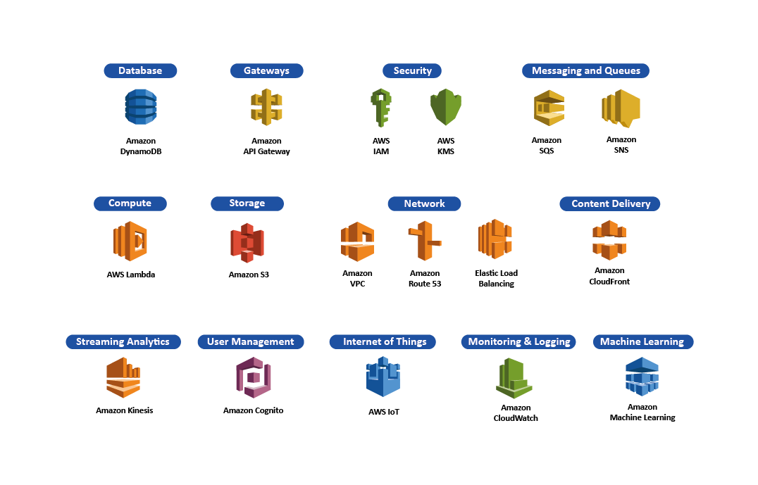
Servicios Serverless en AWS
Notes:
Amazon Web Services (AWS) offers a variety of serverless services that cater to different aspects of application development, deployment, and management. Some of the key serverless services provided by AWS include:
AWS Lambda: A FaaS platform that allows developers to run their code in response to specific events without worrying about server management. Lambda automatically scales, patches, and maintains the underlying infrastructure.
Amazon API Gateway: A fully managed service that makes it easy to create, publish, and maintain secure APIs at scale. API Gateway integrates with AWS Lambda to provide serverless APIs.
Amazon DynamoDB: A managed NoSQL database service that provides fast and predictable performance with seamless scalability. DynamoDB requires no server management, automatically distributing data and traffic across multiple partitions.
AWS Step Functions: A serverless workflow service that enables developers to coordinate the components of distributed applications and microservices using visual workflows.
Amazon S3: A highly-scalable object storage service that enables developers to store and retrieve any amount of data at any time, from anywhere on the web.
Amazon SQS: A managed message queue service that enables decoupling of microservices, distributed systems, and serverless applications.
Amazon SNS: A fully managed pub/sub messaging service that enables event-driven architectures by sending messages to subscribed endpoints, such as Lambda functions or mobile devices.
AWS App Runner: A fully managed service that makes it easy to build, deploy, and scale containerized applications quickly using source code or container images.
AWS EventBridge: A serverless event bus service that connects applications using data from various sources, like SaaS applications or custom applications, to AWS services like Lambda, SQS, or SNS.
Amazon Aurora Serverless: An on-demand, auto-scaling configuration of the Amazon Aurora relational database that automatically adjusts capacity based on actual usage.
Serverless vs SaaS
Serverless services, are cloud-based managed services that abstract away server management, capacity planning, and infrastructure provisioning. They automatically scale with demand and provide cost optimization based on actual usage. Serverless services focus on providing building blocks and infrastructure components that developers can use to create and deploy applications.
SaaS, on the other hand, refers to fully developed software applications that are delivered over the internet and typically accessed via web browsers or APIs. SaaS providers manage the application, infrastructure, and data storage, and customers access the application without worrying about managing the underlying infrastructure or application updates. Examples of SaaS applications include Salesforce, Slack, and Google Workspace.
The key distinction between serverless and SaaS lies in their target audience and scope:
Serverless services are targeted at developers, providing them with building blocks and infrastructure components to create and deploy applications without managing the underlying infrastructure.
SaaS offerings are targeted at end-users or businesses, providing them with ready-to-use applications that can be accessed via the internet without the need to manage the application or infrastructure.
AWS services mentioned earlier, like AWS Lambda, Amazon API Gateway, and Amazon DynamoDB, are considered serverless because they provide infrastructure components and services that developers can use to build applications without managing servers. While these services might be part of a broader SaaS offering, they are not SaaS applications themselves.
In summary, serverless services are focused on providing infrastructure components for application development and deployment, while SaaS offers fully developed applications directly to end-users or businesses.

Slide 13
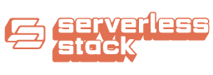
Serverless Stack (SST)
Es un framework de infraestructura como código (IaC) construido en TypeScript sobre Amazon Cloud Development Kit (CDK) para desarrollar y mantener aplicaciones serverless en una sola base de código.

Slide 14
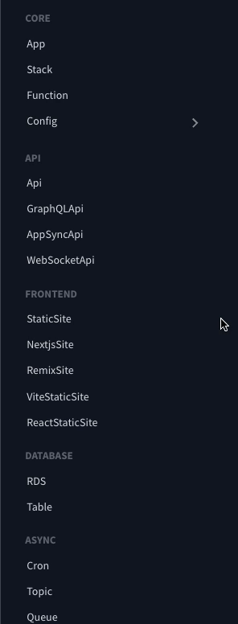
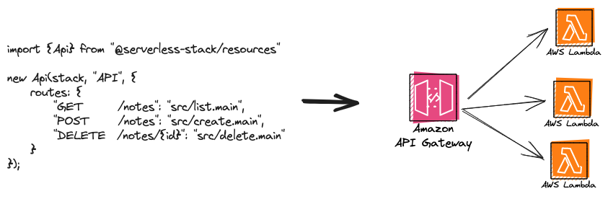
Serverless Stack (SST): Higher Level Constructs

Slide 15
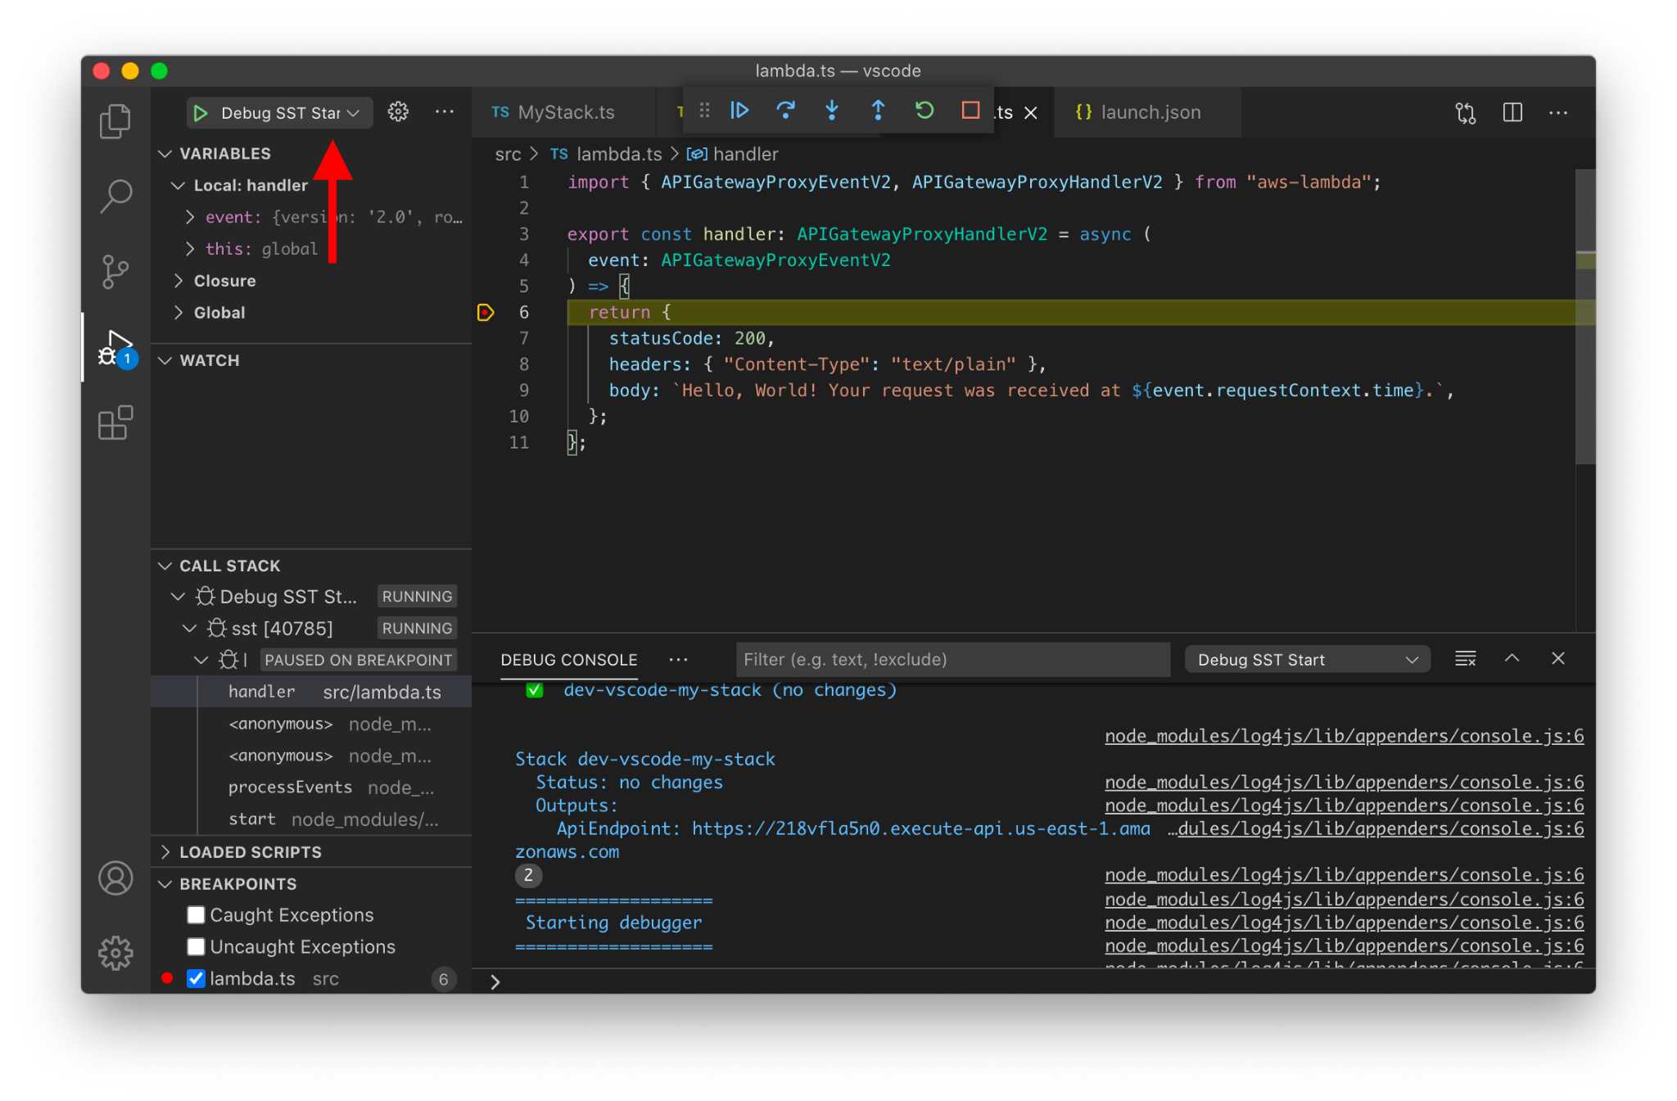
Serverless Stack (SST): Live Lambda Development

Slide 16
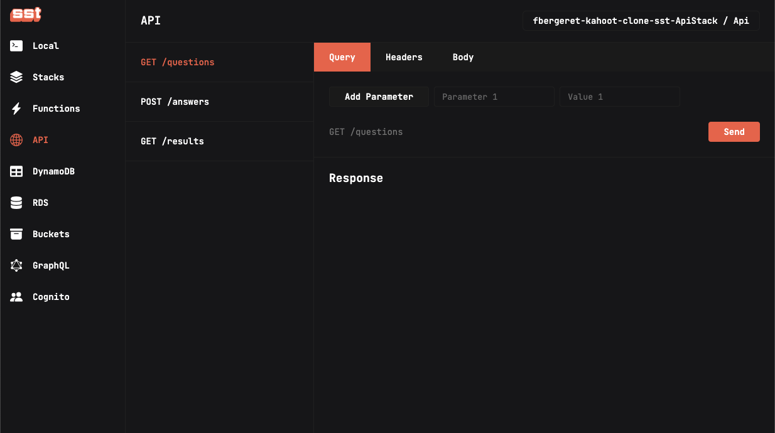
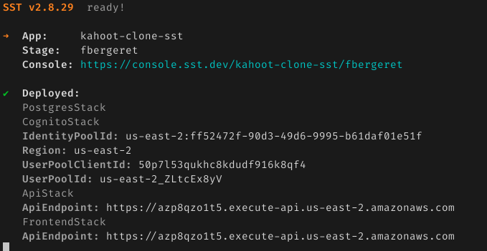
Serverless Stack (SST): Console & Cli

Slide 17
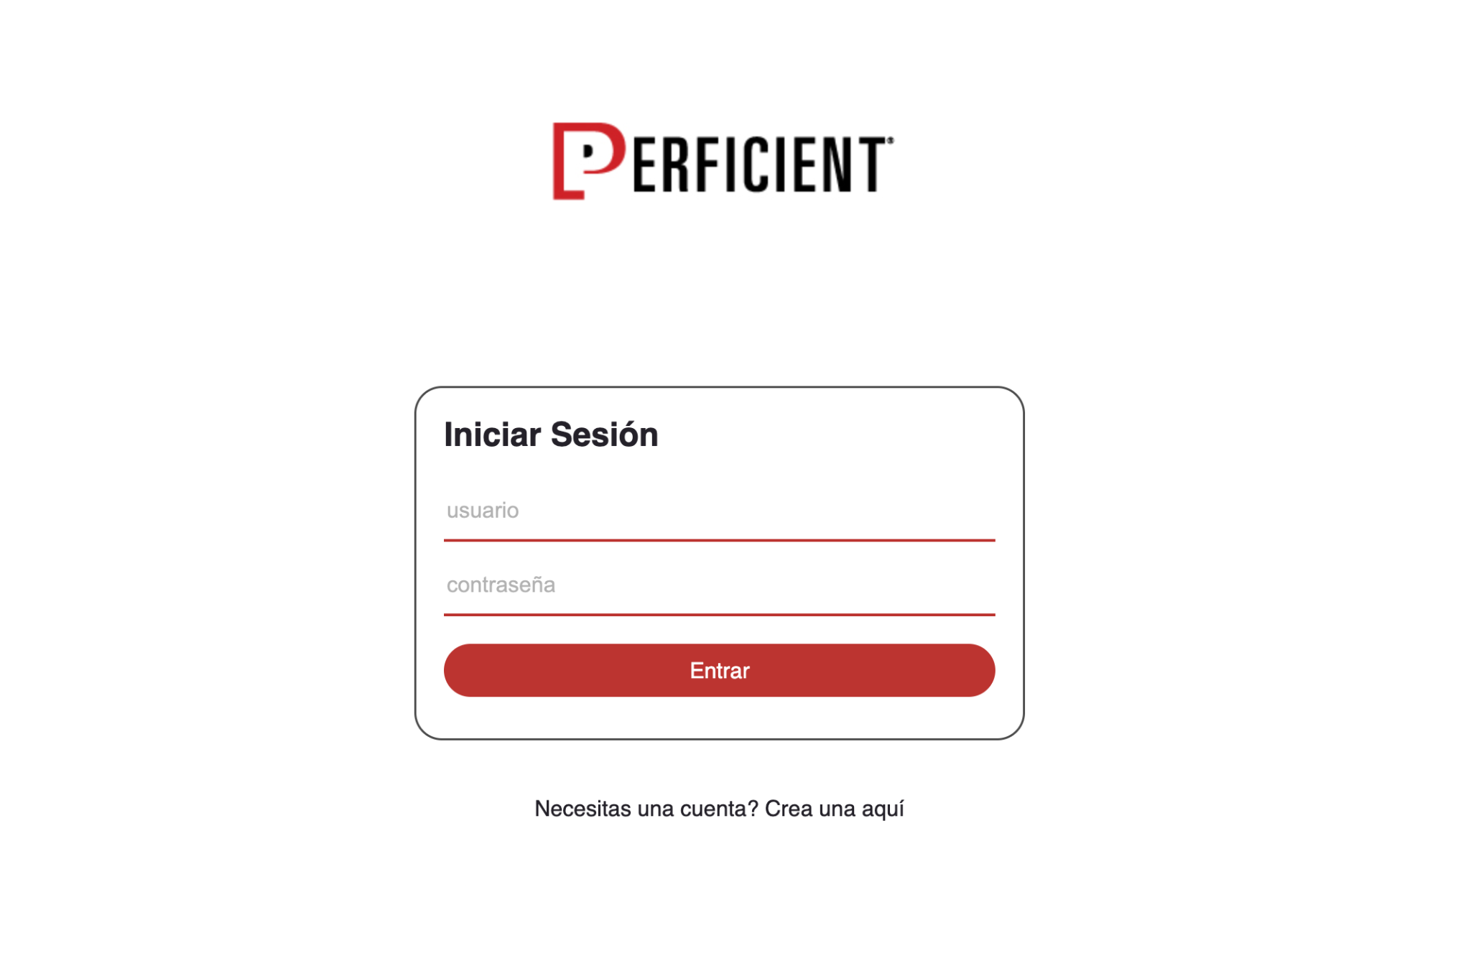
Demo!
Vamos a construir un juego de preguntas y respuestas "al estilo" Kahoot
Los participantes se registrarán y tendrán un tiempo limitado para responder una serie de preguntas.
Al finalizar, ganará el participante con mayor cantidad de preguntas correctas.
En caso de empate ganará aquel que haya contestado en menor tiempo
https://github.com/fbergeret95/kahoot-clone-sst

Slide 18
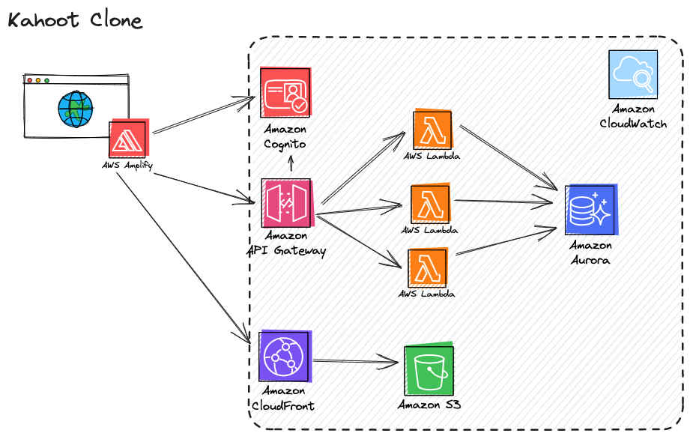
Demo!

Slide 19

Demo!
https://dhb0b9gun7kkq.cloudfront.net

Slide 20

Gracias!

Slide 21


Q&A
Survey

